Slide 1



REDDIT POST – COMMENT RELEVANCE ANALYSIS
-EXPLORING THE NEXUS OF POSTS AND COMMENTS
Rajesh Kumar Reddy Avula
Sai Sindhura Kollepara
Shoukath Ali Shaik
Vineetha Maddikunta

Slide 2


CONTENTS
Problem description
Data Description
Data Visualization
Data Preprocessing
Relevance Metric
Design Thinking Process
AI choice
Results
New insights into problem
Future direction

Slide 3
PROBLEM DESCRIPTION
Objective: To develop a method or tool to automate the assessment of comment relevance and similarity to original posts.
Potential Impact: Enhancing user experience by promoting meaningful discussions, aiding moderators in identifying relevant comments efficiently.
Challenges: Reddit's vastness, Semantic Complexity, Spam and Irrelevant Content Detection

Slide 4
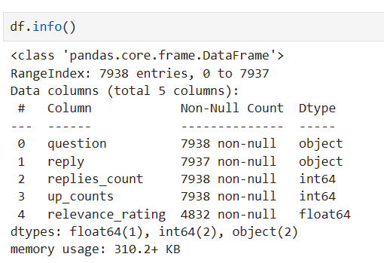
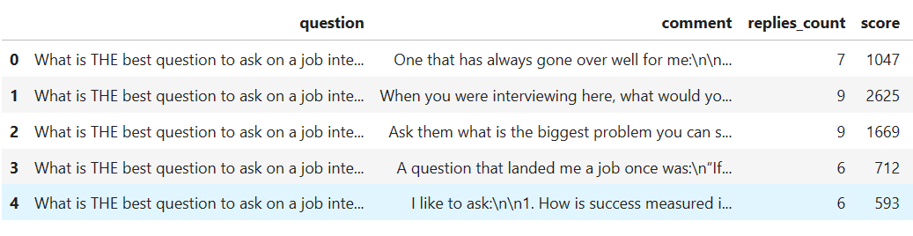
DATA DESCRIPTION
Features collected from Reddit – Title, Comments, Score and Reply counts
Label – Relevance Rating (on scale of 1-5)
Relevance R﻿ating | Description
5 | Most Relevant
4 | Relevant
3 | Neutral
2 | Bad
1 | Terrible

Slide 5
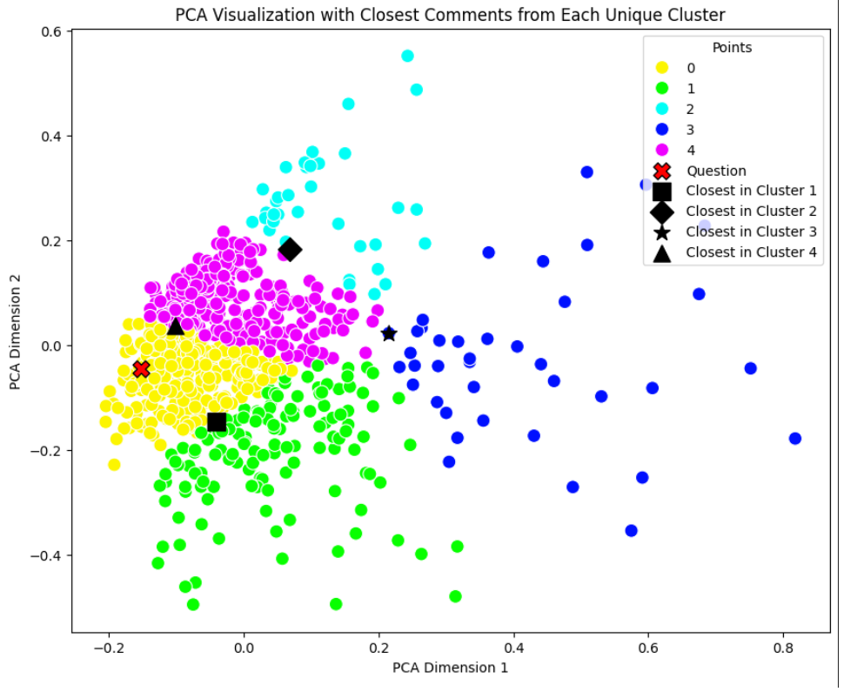
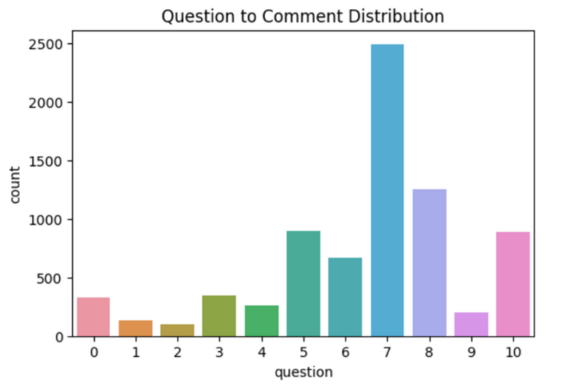
DATA VISUALIZATION

Slide 6
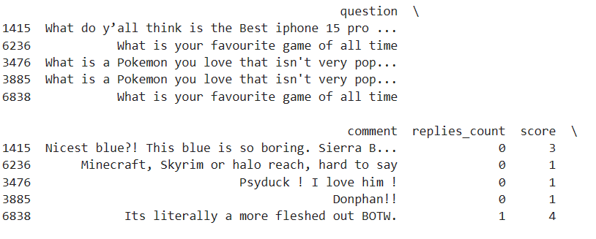
DATA PREPROCESSING
Remove bot generated and deleted/removed comments
Text cleaning – Removing HTML tags, urls, special characters, emojis, etc
Remove duplicate comments (spams)
Handling null values
Calculating cosine similarity, tf-idf vectorization etc.
Defining relevence metric

Slide 7
Relevance Metric
Defining our Relevance Metric, includes
Semantic match factor
Sentiment polarity factor
User engagement factor - Score, reply count
Cluster coherence factor

Slide 8
DESIGN THINKING PROCESS
Step 1: Embeddings to question & comments
Step 2: Cluster the Embeddings
Using different algorithms & models - tfidf, LDA, pre-trained models
Applying defined relevance metric
Step 3: Finding the Relevance of Entire Clusters

Slide 9
AI CHOICE
Latent Dirichlet Allocation (LDA)
Pre-trained Models
BERT
GPT
BERTweet
Long Short-Term Memory (LSTM)

Slide 10
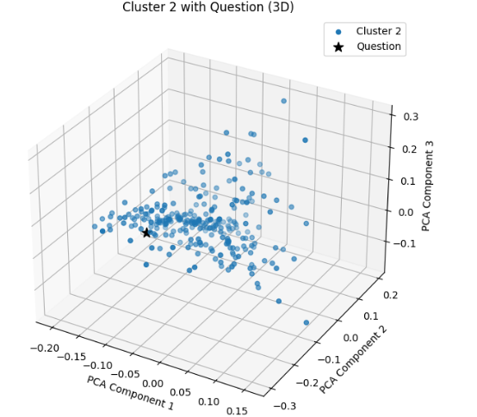
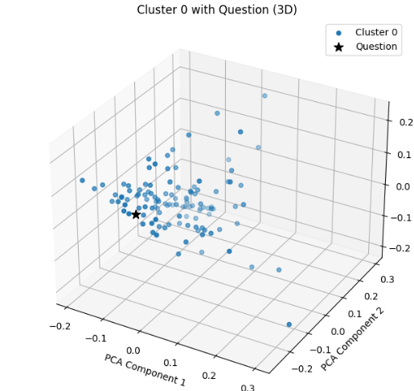
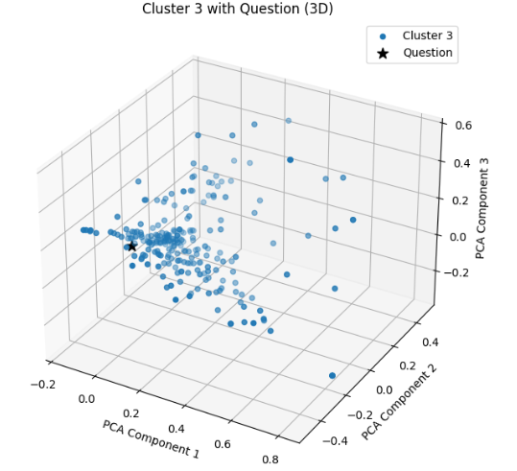
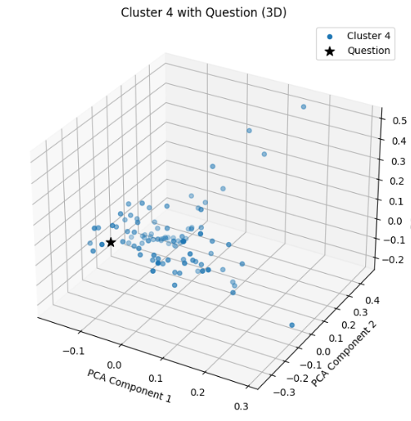
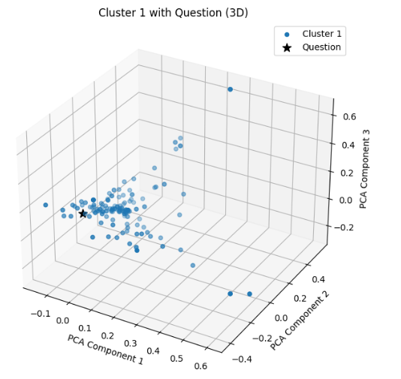
LDA

Slide 11
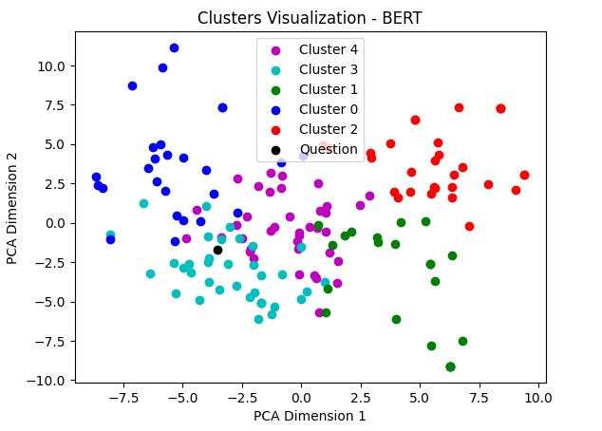
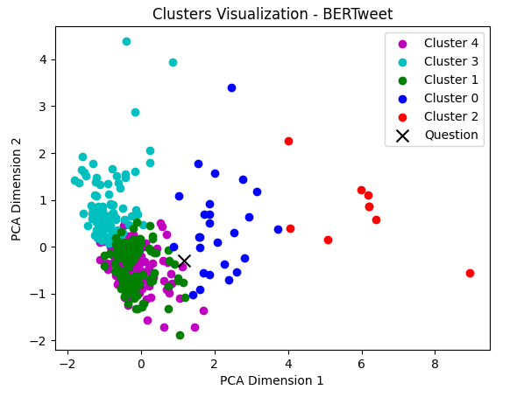
BERT & BERTweet

Slide 12
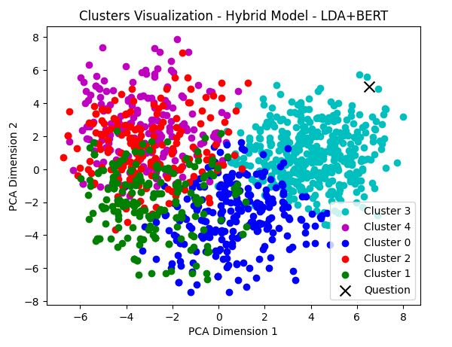
HYBRID MODELS

Slide 13

THANK YOU

